Slide 1
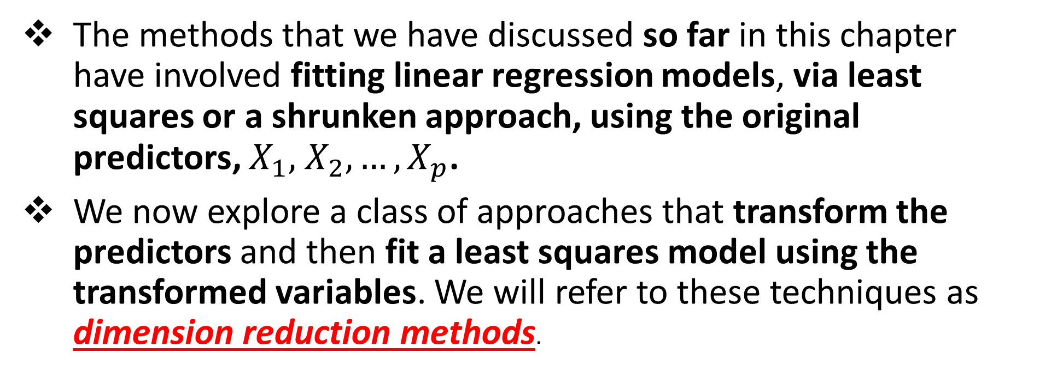
Dimension Reduction Methods
The methods that we have discussed so far in this chapter have involved fitting linear regression models, via least squares or a shrunken approach, using the original predictors, $X_{1},$ $X_{2},…,X_{p}$.
We now explore a class of approaches that transform the predictors and then fit a least squares model using the transformed variables. We will refer to these techniques as dimension reduction methods.

Slide 2
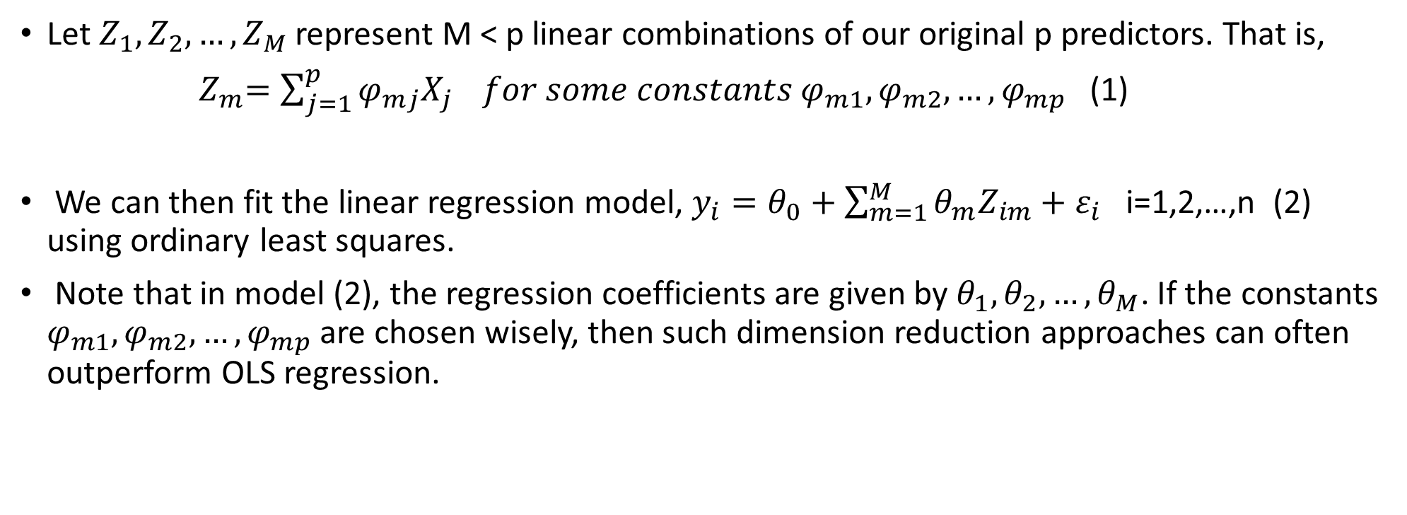
Dimension Reduction Methods: details
Let $Z_{1},Z_{2}, …, Z_{M}$represent M < p linear combinations of our original p predictors. That is,
${ Z}_{m}=\sum_{j=1}^{p}{φ_{mj}X_{j}} for some constants φ_{m1}, φ_{m2},…,φ_{mp}$ (1)
We can then fit the linear regression model, $y_{i}=θ_{0}+\sum_{m=1}^{M}{θ_{m}Z_{im}+ε_{i}}$ i=1,2,…,n (2) using ordinary least squares.
Note that in model (2), the regression coefficients are given by $θ_{1},θ_{2},…,θ_{M}$. If the constants $φ_{m1}, φ_{m2},…,φ_{mp}$ are chosen wisely, then such dimension reduction approaches can often outperform OLS regression.

Slide 3
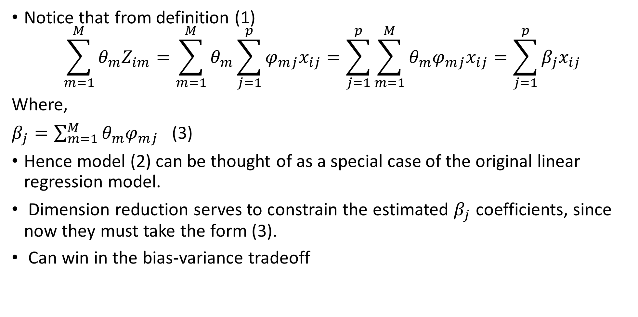
Notice that from definition (1)
$$\sum_{m=1}^{M}{θ_{m}Z_{im}=\sum_{m=1}^{M}{θ_{m}\sum_{j=1}^{p}{φ_{mj}x_{ij}=\sum_{j=1}^{p}{\sum_{m=1}^{M}{θ_{m}φ_{mj}x_{ij}=\sum_{j=1}^{p}{β_{j}x_{ij}}}}}}}$$
Where,
$β_{j}=\sum_{m=1}^{M}{θ_{m}φ_{mj}}$ (3)
Hence model (2) can be thought of as a special case of the original linear regression model.
Dimension reduction serves to constrain the estimated $β_{j}$ coefficients, since now they must take the form (3).
Can win in the bias-variance tradeoff

Slide 4
Principal Components Regression
Here we apply principal components analysis (PCA) to define the linear combinations of the predictors, for use in our regression.
The first principal component is that (normalized) linear combination of the variables with the largest variance.
The second principal component has largest variance, subject to being uncorrelated with the first.
And so on.
Hence with many correlated original variables, we replace them with a small set of principal components that capture their joint variation.

Slide 5
Pictures of PCA
The population size (pop) and ad spending (ad) for 100 different cities are shown as purple circles. The green solid line indicates the first principal component, and the blue dashed line
indicates the second principal component.

Slide 6
Pictures of PCA: continued
A subset of the advertising data.
Left: The first principal component, chosen to minimize the sum of the squared perpendicular distances to each point, is shown in green. These distances are represented using the black dashed line segments.
Right: The left-hand panel has been rotated so that the first principal component lies on the x-axis.

Slide 7
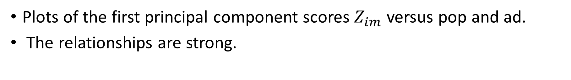
Pictures of PCA: continued
Plots of the first principal component scores $Z_{im}$ versus pop and ad.
The relationships are strong.

Slide 8
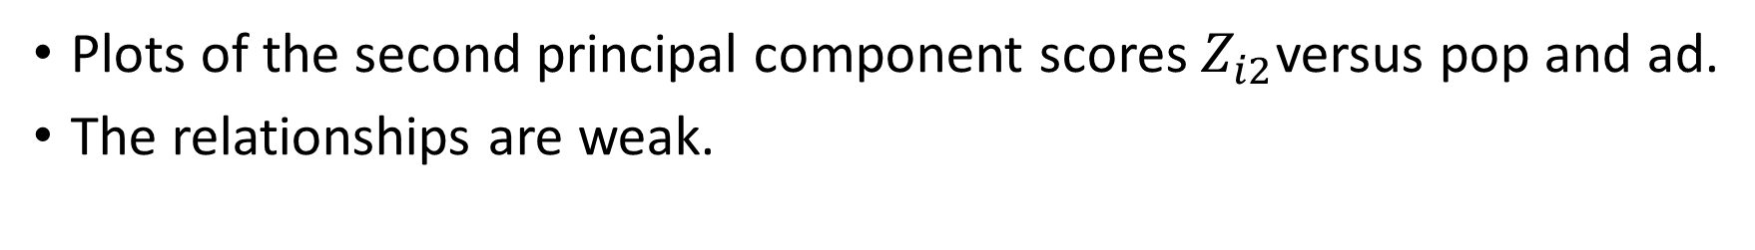
Pictures of PCA: continued
Plots of the second principal component scores $Z_{i2}$versus pop and ad.
The relationships are weak.

Slide 9
Application to Principal Components Regression
PCR was applied to two simulated data sets. The black, green,
and purple lines correspond to squared bias, variance, and test
mean squared error, respectively.

Slide 10
Choosing the number of directions M
Left: PCR standardized coefficient estimates on the Credit data set for different values of M.
Right: The 10-fold cross validation MSE obtained using PCR, as a function of M

Slide 11
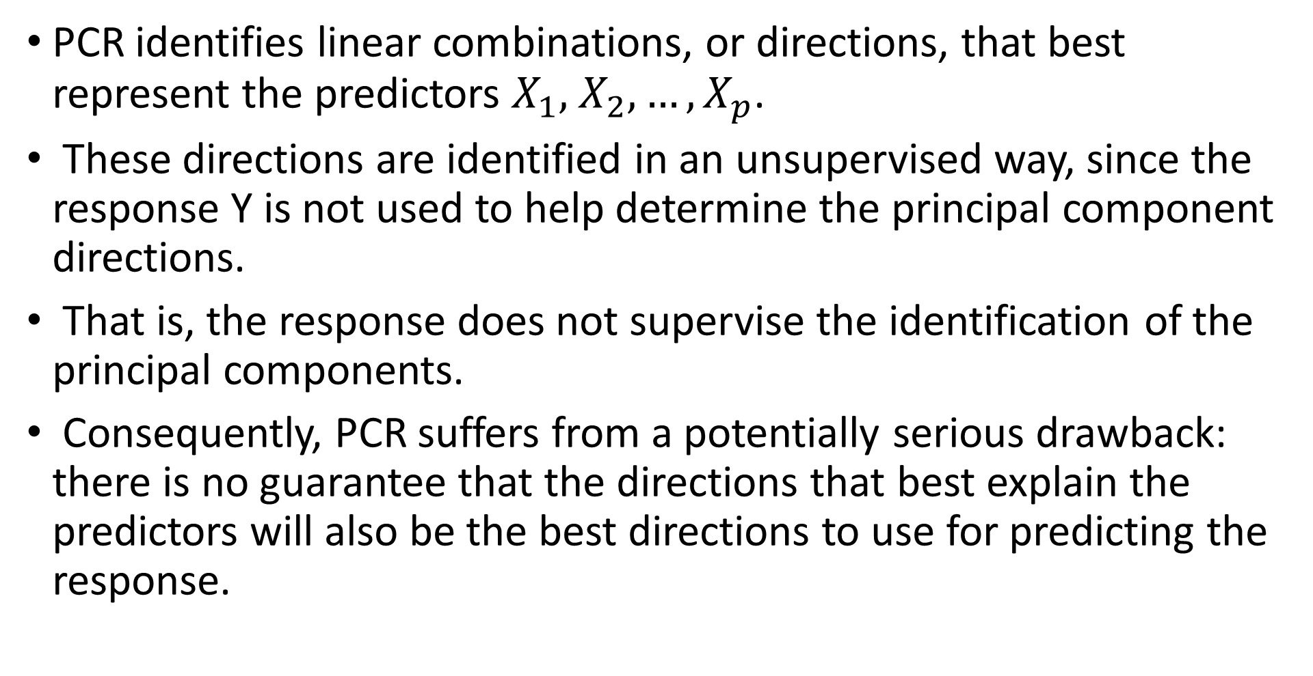
Partial Least Squares
PCR identifies linear combinations, or directions, that best represent the predictors $X_{1},$ $X_{2},…,X_{p}$.
These directions are identified in an unsupervised way, since the response Y is not used to help determine the principal component directions.
That is, the response does not supervise the identification of the principal components.
Consequently, PCR suffers from a potentially serious drawback: there is no guarantee that the directions that best explain the predictors will also be the best directions to use for predicting the response.

Slide 12
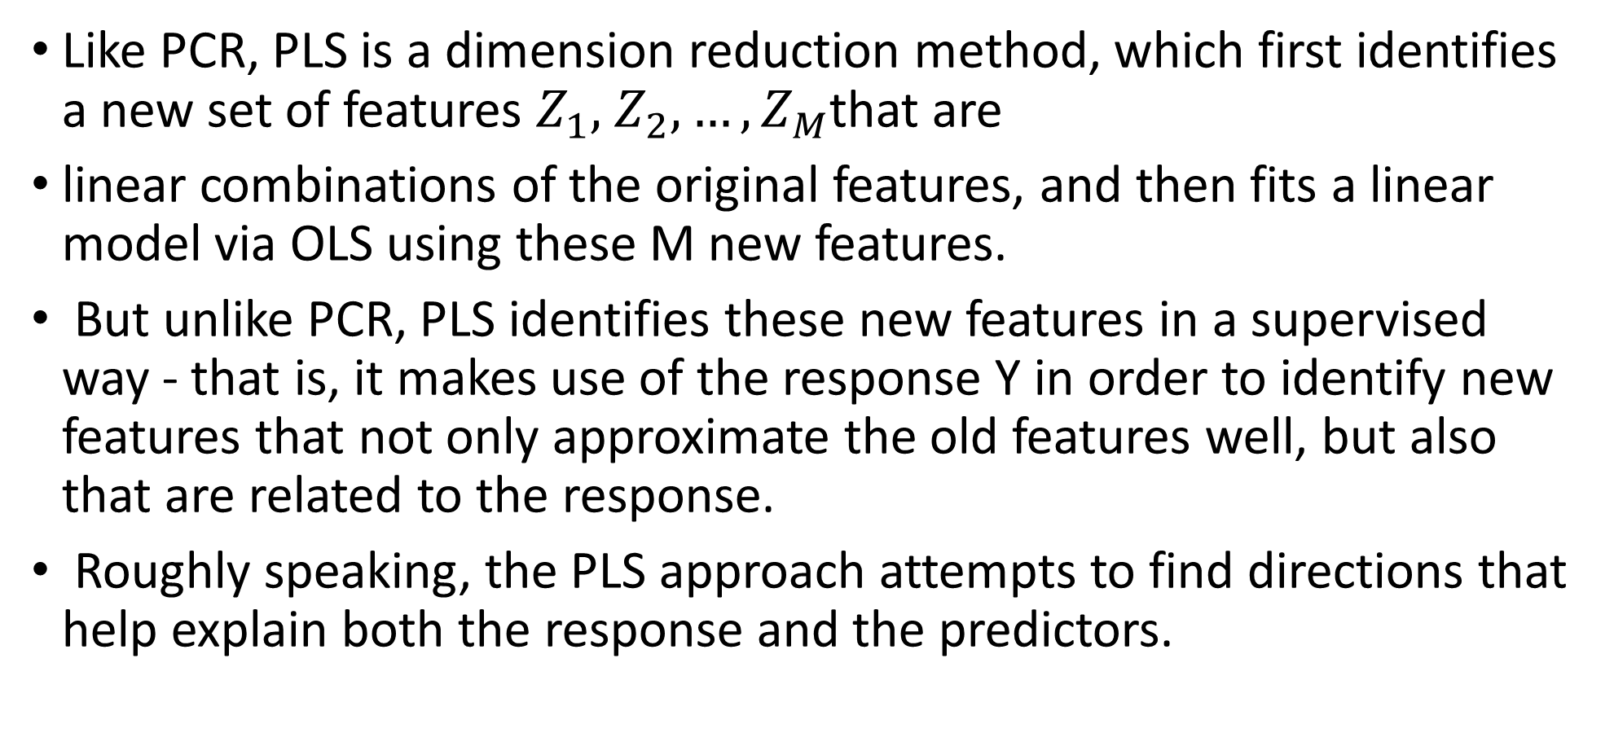
Partial Least Squares: continued
Like PCR, PLS is a dimension reduction method, which first identifies a new set of features $Z_{1},$ $Z_{2},…,Z_{M}$that are
linear combinations of the original features, and then fits a linear model via OLS using these M new features.
But unlike PCR, PLS identifies these new features in a supervised way - that is, it makes use of the response Y in order to identify new features that not only approximate the old features well, but also that are related to the response.
Roughly speaking, the PLS approach attempts to find directions that help explain both the response and the predictors.

Slide 13
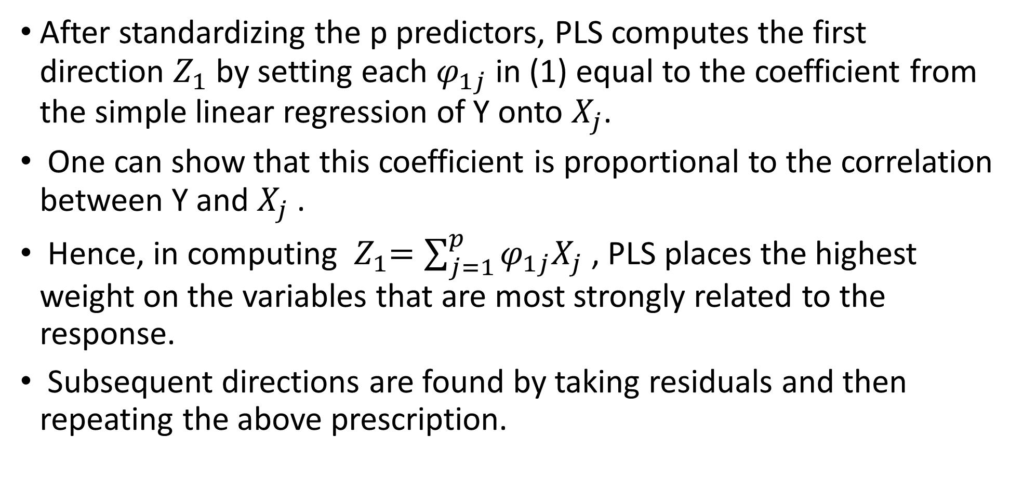
Details of Partial Least Squares
After standardizing the p predictors, PLS computes the first direction $Z_{1}$ by setting each $φ_{1j}$ in (1) equal to the coefficient from the simple linear regression of Y onto $X_{j}$.
One can show that this coefficient is proportional to the correlation between Y and $X_{j}$ .
Hence, in computing ${ Z}_{1}=\sum_{j=1}^{p}{φ_{1j}X_{j}}$ , PLS places the highest weight on the variables that are most strongly related to the response.
Subsequent directions are found by taking residuals and then repeating the above prescription.

Slide 14
Summary
Model selection methods are an essential tool for data analysis, especially for big datasets involving many predictors.
Research into methods that give sparsity, such as the lasso is an especially hot area.
Later, we will return to sparsity in more detail, and will describe related approaches such as the elastic net.

Slide 16
PURPOSE OF FACTOR ANALYSIS
Simplification - identifying basic underlying factors (or dimensions or constructs) that explain relationships among a larger number of other
how much of the variation in a large number of variables can be accounted for by a very much smaller number of factors or underlying dimensions
It condenses information contained in a number of original variables into a smaller set of dimensions (factors) with a minimum loss of information:
Factor analysis extends correlation, by analysing complex interactions between variables.

Slide 17
EXAMPLES OF CONDENSING VARIABLES TO A SMALLER NUMBER OF FACTORS
Variables | Factors
Friendly Courteous Competent etc | Hotel Employee Quality
Room size Bed size View Cost etc | Hotel Room Quality
Extensive menu choice Service and attention Cleanliness etc | Hotel Catering Quality

Slide 18
FACTORS
Factors are the underlying dimensions or constructs to which highly inter-correlated variables are subordinate.
E.G. The super-ordinate factor of Room Quality on a previous slide contains variables like cost, room size, bed size etc
Factors are also called Dimensions, and Constructs in the literature.

Slide 19
THEORETICAL INTRODUCTION
There are 2 closely related types of factor analysis:
Explanatory Factor Analysis (EFA)
aims to reduce large number of variables into a smaller number of factors and thereby identify the factor structure or model - EFA is exploratory
Confirmatory Factor Analysis (CFA)
aims to confirm theoretical predictions whether a specified set of constructs is influencing responses in a predicted way - CFA provides a way of confirming that the factor structure or model obtained in an EFA study is robust

Slide 20
CHARLES SPEARMAN AND LATENT MENTAL ABILITIES
Factor analysis began with Spearman (1863-1945) who applied a set of 20 academic tests to estimate the intelligence of a group of children.
On calculating correlations between each of the individual tests he found that they were strongly correlated with one another.
Spearman therefore concluded that he wasn’t actually measuring 20 completely different things, rather measuring a much smaller number of underlying abilities.

Slide 21
CHARLES SPEARMAN AND LATENT MENTAL ABILITIES
The test scores were all correlated because there were intellectual abilities common to all the tests.
Two options existed:
1. The strong positive correlations reflected a single underlying general factor (a general intelligence) along with a specific aptitude for each individual test, or
2. The positive correlations reflected the existence of a small set of underlying abilities. And so the mind could be seen as comprising a small set of separate “compartments” for arithmetic, verbal ability, spatial ability, etc.

Slide 22
CHARLES SPEARMAN AND LATENT MENTAL ABILITIES
Spearman opted for the first option, with performance on a single test to be the product of 2 things (i). underlying general intelligence, plus (ii). specific ability for that test.
Today we accept the notion that there exists a small number of underlying mental abilities that explains performance across a range of academic tests.

Slide 23
PERSONALITY FACTORS
In a similar way Cattell and Eysenck determined the basic underlying personality factors that underlie a huge variety of personality descriptors using factor analysis e.g. introversion-extraversion, neuroticism etc. are the superordinate personality dimensions

Slide 24
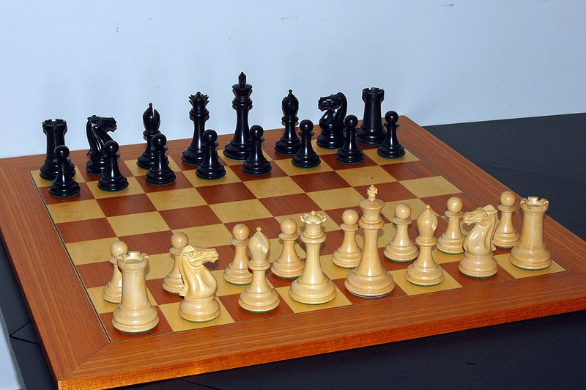
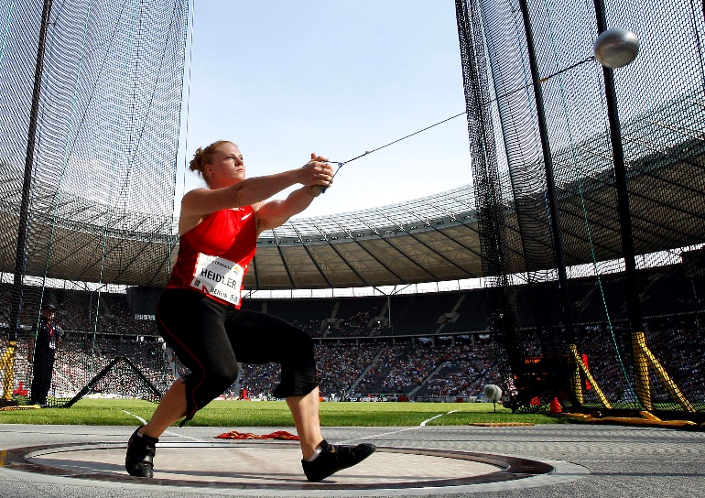


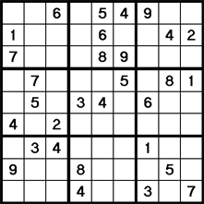
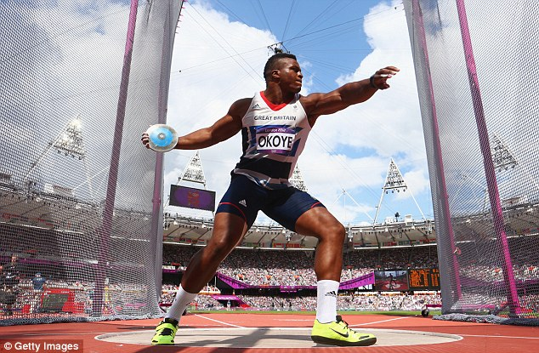
Chess Hammer Throw Bridge
Shot Put Sudoku Discus

Slide 25
EXAMPLE OF CORRELATION MATRIX REVEALING UNDERLYING FACTORS
 | Chess | Bridge | Sudoku | Discus | Hammer Throw | Shot Put
Chess | 1.00 | 0.89 | 0.85 | 0.03 | 0.01 | 0.04
Bridge | 0.89 | 1.00 | 0.80 | -0.05 | 0.02 | -0.03
Sudoku | 0.85 | 0.80 | 1.00 | -0.04 | -0.07 | 0.02
Discus | 0.03 | -0.05 | -0.04 | 1.00 | 0.76 | 0.71
Hammer Throw | 0.01 | 0.02 | -0.07 | 0.76 | 1.00 | 0.85
Shot Put | 0.04 | -0.03 | 0.02 | 0.71 | 0.85 | 1.00

Slide 26
INTERPRETATION OF THE CORRELATION MATRIX
Notice the pattern of correlations and factor loadings in the tables above.
Chess, Bridge and Sodoku are highly related while Discus, Hammer and Shot form another highly correlated group.
Members of one grouping have minimum relationships (random r close to zero) with members of the other.
Therefore two underlying factors are evident – perhaps we could name them as logical thinking and physical strength.

Slide 27
SELECTING THE FACTORS
Kaiser’s rule:
choose factors with eigenvalues > 1. Components with eigenvalues greater than one explain more variation than an original item.
Scree Plot:
successive eigenvalues are plotted on a graph. Keep those components above the point where the plot abruptly levels out. The flattened area is accumulation of scree or rubbish, factors of no real importance.

Slide 28
EXAMPLE OF SCREE PLOT : 2 OR 3 FACTORS?

Slide 29
AN EXAMPLE
Suppose we were to ask employees 12 questions about their supervisors & leadership:
1 My supervisor sets an example by working hard
2 My supervisor displays a high level of specialist knowledge and skill
3 My supervisor focuses on dealing with issues related to people
4 My supervisor is cooperative
5 My supervisor makes it clear what rewards employees will receive for performance
6 My supervisor generates enthusiasm in subordinates
7 My supervisor consults employees regarding changes and their implementation
8 My supervisor shares information with employees
9 My supervisor effectively implements company policy
10 My supervisor effectively delegates responsibility
11 My supervisor provides rewards in return for hard work
12 My supervisor concentrates on task coordination

Slide 30
AN EXAMPLE
We might get responses which tell us about 12 different things, but we might also conceivably get responses which only tell us one thing – how much the employee likes the supervisor
If we are, indeed, measuring essentially one thing, then we’d expect responses from employees on these 12 supervision questions to all be highly inter-correlated.
Most often, we will have a situation which is somewhere between these two extremes, and our 12 questions will be actually measuring somewhere between one, and twelve different things.
To try and help decide what we are actually measuring we can look at the correlation matrix:

Slide 31
PCA – An example

Slide 32
AN EXAMPLE
But it’s far too difficult to make any sense out of so many individual bivariate correlations. We cannot eyeball the patterns
To try and make sense we use Principal Components Analysis – a type of Factor Analysis.

Slide 33
PRINCIPAL COMPONENT ANALYSIS (PCA)
PCA is the statistical approach that derives a linear combination of variables (like Regression) such that maximum variance is extracted from the variables to identify the main factor.
It then removes this variance and derives another linear combination which explains the maximum proportion of remaining variance and so on through successive iterations to produce less important factors.

Slide 34
ASSUMPTIONS FOR PERFORMING A PCA
Large enough sample to yield reliable estimates of the correlations among the variables i.e. large ratio of N / variables usually at least 5 : 1, preferably 10 : 1
Statistical inference is improved if the variables are at least approximately normal
Linear relationships among all the pairs of variables
Absence of outliers among the cases
Interval data

Slide 35
PCA
PCA will tell us:
1. How many underlying dimensions (called “components” or “factors”) appear to be represented in the responses to our items.
2. The proportion of total variation in the variables which is explained by these underlying dimensions.
3. The extent to which we may consider each item is composed of each of these underlying dimensions (via component or factor loadings).
4. And finally, the analysis will also give us a score (a “factor score”) for each of the cases in our sample on each of the underlying dimensions.

Slide 36
IS THE DATA SUITABLE FOR A FACTOR ANALYSIS?
Step 1:
Firstly we look at our correlation matrix.
Since PCA explains and summarizes the correlations between variables, if there are very low correlations between variables, there is no underlying factor and no need to continue.

Slide 37
IS IT WORTHWHILE CONDUCTING A FACTOR ANALYSIS?
Tabachnick and Fidell (1996, p. 641) state:
“A matrix that is factorable should include several sizable correlations. The expected size depends, to some extent, on N (larger sample sizes tend to produce smaller correlations), but if no correlation exceeds .30, use of FA is questionable because there is probably nothing to factor analyze.”

Slide 38
IS IT WORTHWHILE CONDUCTING A FACTOR ANALYSIS?
Step 2. Inspect two Statistics Requested.
the Kaiser-Meyer-Olkin Measure of Sampling Adequacy. This should be greater than .6. KMO>0.6
Bartlett’s Test of Sphericity. This should be large and statistically significant.

Slide 39
IS IT WORTHWHILE CONDUCTING A FACTOR ANALYSIS?
In this case, the Kaiser-Meyer-Olkin Measure of Sampling Adequacy = .873, i.e. greater than .6. Bartlett’s Test of Sphericity has a large chi-square value which is highly significant (χ₆₆² = 2693.452, p < .0005). So by each of these criteria it is appropriate to apply Principal Components Analysis to this data set.

Slide 40
SELECTING FACTORS
Step 2: How many components are there? And how much do they explain?
PCA initially produces as many theoretical underlying dimensions (factors) as there were original variables, so in this case we have produced 12 theoretical dimensions to explain the scores on 12 observed items.
The question is, can a relatively small number of these underlying dimensions (components) explain much of the variation in scores across the 12 items?
There are a number of ways to select this small number of dimensions.

Slide 41
EIGENVALUES
The simplest answer is to choose those dimensions with eigenvalues that are greater than 1.
A component with an eigenvalue which is less than 1 explains less variance than did an individual item in the original data set.
Components with eigenvalues greater than 1 are components which explain more variation than did an original item.

Slide 42
EIGENVALUES AND FACTORS
Here 3 components have eigenvalues that are greater than 1. We would report that “the PCA extracted three components or factors.”

Slide 43
THE UNROTATED SOLUTION
The following table presents the unrotated component matrix. This is the initial solution provided by Principal Components Analysis.
The three components are not correlated with each other (they are “orthogonal”).
The Component Matrix below shows the loading of each item on to each of underlying components.

Slide 44
The Unrotated Component Matrix
Unrotated loadings are often difficult to interpret.

Slide 45
ROTATION
It is often not always easy to identify meaningful factors in an unrotated matrix. The best way to identify meaningful factors is to rotate the factors.
Rotating factors attempt to find a factor solution that is equal to that obtained in the initial extraction but which has the simplest interpretation

Slide 46
THE ROTATED COMPONENT MATRIX
The rotated loadings (in this case varimax) are often easier to interpret.

Slide 47
TYPES OF ROTATION
There are two major categories of rotations,
orthogonal rotations, which produce uncorrelated factors
oblique rotations, which produce correlated factors.
The best and most commonly used orthogonal rotation is Varimax which increases discrimination between high and low variables. It produces a ‘simple structure’
Oblique rotations are less common; the three most used being Direct Quartimin, Promax, and Oblimin.

Slide 48
ORIGINAL FACTOR STRUCTURE

Slide 49
VARIMAX ROTATED FACTORS – BETTER FIT

Slide 50
VARIANCE EXPLAINED
Examining the “Rotated Sums of Squared Loadings” Component 1 explains 31.566% of the variance, Component 2, 27.757%, and Component 3, 8.941% of the variance in the original variables. i.e. 68.264% of the total variance in the original set of variables.

Slide 51
THE SCREE PLOT
We may not always be interested in all of the components with eigenvalues greater than one. An alternative method of deciding how many components should be considered is the scree plot.
This method would typically
be used to further reduce
the number of components
from the number that might
be accepted on the basis
of the eigenvalues.

Slide 52
THE SCREE PLOT
When you plot the eigenvalues of the components in a scree plot, typically you find that the scree plot can be divided into two sections. First, on the left, we see a sharp drop
from the value of the first component.
Then, the graph presents
a relatively flat horizontal
section terminating with
the eigenvalue of the
last component.

Slide 53
THE SCREE PLOT
The rule of thumb when interpreting the scree plot is to only consider those first few components which are NOT on the flat horizontal section of the figure.
In this example, the figure
flattens out at Component 3,
so by using this rule of
thumb and our observations
of the scree plot, we would
only consider Component 1
and Component 2 to be
important.

Slide 54
INTERPRETING COMPONENTS
Step 3: Making sense of the Components - Can we name them and how do they relate to our items?
To understand what the underlying components actually might represent requires us to look at the relationship of each of the items to each of the theoretical components.
We do this by examining the component loadings.

Slide 55
WHAT DO THE FACTORS MEAN?
PCA produces theoretical underlying components (or “dimensions” or “factors”) but it does not tell us what they mean.
It does, however, tell us the degree to which each of our variables (or items) relates to each of the components.
By looking at these relationships we try and make some sense as to what these components might represent (this is not always possible, and some components may not be “interpretable”.)

Slide 56
INTERPRETATION
Items 1 and 6 are “complex items” with loadings on more than one Component.
Rotated Component Matrixª
Component
1
2
3
7 My supervisor consults me regarding changes and their implementation
.891
8 My supervisor shares information with me
.872
3 My supervisor focuses on dealing with issues related to people
.846
4 My supervisor is cooperative
.788
10 My supervisor effectively delegates responsibility
.744
11 My supervisor provides rewards in return for hard work
.895
9 My supervisor effectively implements company policy
.825
12 My supervisor concentrates on task coordination
.822
5 My supervisor makes it clear what rewards they will receive for performance
.741
1 My supervisor sets an example by working hard himself or herself
.580
.691
2 My supervisor displays a high level of specialist knowledge and skill
.883
6 My supervisor generates enthusiasm in his or her subordinates
.351
.501
Extraction Method: Principal Component Analysis.
Rotation Method: Varimax with Kaiser Normalization.
a.
Rotation converged in 3 iterations.

Slide 57
INTERPRETATION
Items 7, 8, 3, 4, and 10, all have loadings on Component 1 (and none on components 2 or 3).
Rotated Component Matrixª
Component
1
2
3
7 My supervisor consults me regarding changes and their implementation
.891
8 My supervisor shares information with me
.872
3 My supervisor focuses on dealing with issues related to people
.846
4 My supervisor is cooperative
.788
10 My supervisor effectively delegates responsibility
.744
11 My supervisor provides rewards in return for hard work
.895
9 My supervisor effectively implements company policy
.825
12 My supervisor concentrates on task coordination
.822
5 My supervisor makes it clear what rewards they will receive for performance
.741
1 My supervisor sets an example by working hard himself or herself
.580
.691
2 My supervisor displays a high level of specialist knowledge and skill
.883
6 My supervisor generates enthusiasm in his or her subordinates
.351
.501
Extraction Method: Principal Component Analysis.
Rotation Method: Varimax with Kaiser Normalization.
a.
Rotation converged in 3 iterations.
Component 1 : might label this component as Supervisory Consultation and Cooperation.
Component 2: might label this component as Instrumental Supervision.

Slide 58
INTERPRETATION
Commonly the items with the largest loadings on a Component gives the greatest clue as to what the Component might represent.
In this case, it would appear that Component 1 is measuring something relating to the degree to which the supervisor is consultative and works in a cooperative manner with staff as all the items reflect positive interaction or a person focus to the supervision process.
We might label this underlying component as Supervisory Consultation and Cooperation.

Slide 59
INTERPRETATION
Items 11, 9, 12, and 5, all have loadings on Component 2, and no loading on either of the other two components.
Rotated Component Matrixª
Component
1
2
3
7 My supervisor consults me regarding changes and their implementation
.891
8 My supervisor shares information with me
.872
3 My supervisor focuses on dealing with issues related to people
.846
4 My supervisor is cooperative
.788
10 My supervisor effectively delegates responsibility
.744
11 My supervisor provides rewards in return for hard work
.895
9 My supervisor effectively implements company policy
.825
12 My supervisor concentrates on task coordination
.822
5 My supervisor makes it clear what rewards they will receive for performance
.741
1 My supervisor sets an example by working hard himself or herself
.580
.691
2 My supervisor displays a high level of specialist knowledge and skill
.883
6 My supervisor generates enthusiasm in his or her subordinates
.351
.501
Extraction Method: Principal Component Analysis.
Rotation Method: Varimax with Kaiser Normalization.
a.
Rotation converged in 3 iterations.

Slide 60
INTERPRETATION
It would appear that Component 2 is measuring something which relates much less to “people” and more to tasks, procedures, and transactions.
We might label this underlying component as Instrumental Supervision. (You might not agree with these labels and you might think of some different labels.)

Slide 61
INTERPRETATION
Only item 2 has a loading on Component 3 and no loading on either of the other two components.
Rotated Component Matrixª
Component
1
2
3
7 My supervisor consults me regarding changes and their implementation
.891
8 My supervisor shares information with me
.872
3 My supervisor focuses on dealing with issues related to people
.846
4 My supervisor is cooperative
.788
10 My supervisor effectively delegates responsibility
.744
11 My supervisor provides rewards in return for hard work
.895
9 My supervisor effectively implements company policy
.825
12 My supervisor concentrates on task coordination
.822
5 My supervisor makes it clear what rewards they will receive for performance
.741
1 My supervisor sets an example by working hard himself or herself
.580
.691
2 My supervisor displays a high level of specialist knowledge and skill
.883
6 My supervisor generates enthusiasm in his or her subordinates
.351
.501
Extraction Method: Principal Component Analysis.
Rotation Method: Varimax with Kaiser Normalization.
a.
Rotation converged in 3 iterations.

Slide 62
INTERPRETATION
Only one item, item 2 “My supervisor displays a high level of specialist knowledge and skill”, has a loading on Component 3 without a loading on any other Component.
Generally, if a Component has 3 or less loading onto it (and these items do not also have loadings on other components), it is often considered likely to not be reliable and the researcher will usually choose not to attempt an interpretation.
In this case, given only two items loaded onto Component 3, and one of these was a complex item with a loading on Component 2 as well, we won’t attempt to interpret Component 3. (Note that, in this case, this decision is also consistent with the results of the scree test.)

Slide 63
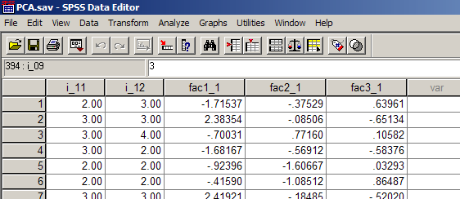
FACTOR SCORES
Step 4: Generating scores for each case on our underlying dimensions via factor scores.
PCA also provides us with a profile of each case in terms of the components. These are the Factor Scores.

Slide 64
FACTOR SCORES
The variable fac1_1 and fac2_2 represent the factor scores on Component 1 and 2 respectively. So for each individual we now have a score for Supervisory Consultation and Cooperation (fac1_1) and Instrumental Supervision (fac2_1).
We have successfully reduced 12 variables (questionnaire items) asking specific questions about leadership down to two variables representing two general concepts of leadership.

Slide 65
FACTOR SCORES
The factor scores may now be used in subsequent analyses.
For example, if the data in our data file represented the responses from more than one firm, we could run an analysis of variance to compare the different firms’ scores on each of these two dimensions. Or we could use any other grouping that might be appropriate for our particular sample. We could also see if these new variables were correlated with any other items that were not used in the PCA.

Slide 66
PCA IN BUSINESS RESEARCH
First, it can be used to help decide how many underlying dimensions are important within a particular domain. For example, it can help provide an answer to questions such as:
How many distinctly different aspects of CEO leadership exist?

Slide 67
PCA IN BUSINESS RESEARCH
Second, PCA can be used to reduce the length of a questionnaire.
For example, if your pilot questionnaire was several hundred questions long and 40 items all loaded onto a single component, you would conclude that these 40 items are all actually measuring a single underlying property.
It would be logical to reduce this number of items and choose, in the future, to only include the few items (say 5) which loaded most strongly onto the underlying component.

Slide 68
PROBLEMS WITH NAMING FACTORS
Naming Factors is subjective; a factor should bear a name that reflects the most important variables that load on it.
The initial choice of tests or items govern the validity of the final outcome of the factor structure that emerges
Alternative orthogonal and oblique solutions as well as rotational solutions may produce valid but different structures
When reading a research article using factor analysis consider carefully whether the name the researcher gives to a factor really does capture the essence of the items, qualities or opinions that load on it

